Slide 1

Schema Design
19 May 2017
Dave Kemp -- NSA, Cybersecurity Architecture and Strategies

Slide 2
Status
Updates since Sept 2016 Forum face-to-face:
Implementation: Python classes --> JAEN document
Test-driven design, full suite of unit tests using example data
Encoder methods
JSON-minified serialization format
Flattened API supports dicts and arrays
Targets: CybOX 2.1 --> streamlined STIX Cyber Observables
Attribute {“type”: “ipv4”, “value”: “1.2.3.4”} --> Property {“ipv4”: “1.2.3.4”}
Response: action --> separate datatype
Modifiers: refactored

Slide 3
Purpose: Interoperability
Schema serves two independent purposes:
Message Definition and Validation
Unambiguous specification
Required even without serialization
Message Serialization
API / JSON – standard, human readable, ensures interoperability
Optional Transformations: (JSON-Minified, Binary) – allows performance optimization if supported by both sender and receiver

Slide 4
Message Definition and Validation
Database: SQL vs NoSQL
NoSQL databases are built to allow the insertion of data without a predefined schema. Developers have typically had to add application-side code to enforce data quality controls, such as mandating the presence of specific fields, data types or permissible values.
--- “NoSQL Databases Explained”, https://www.mongodb.com/nosql-explained
SQL query is just text. NoSQL models require coding in some language.
“The more the DB engine knows about the Data Model, the more it can do for you”
Best practice: use right tool for the job – SQL *and* NoSQL
Protocol data models: Schema vs. Property tables
No schema: Validation requires program coding, updates require re-coding
Schema is just text: Codec/validation engine doesn’t change when protocol is updated
Notes:
The OpenC2 standard defines a static data model.

Slide 5
Message Serialization
Serialization is a network layer six function:
“The Presentation layer provides independence from data representation by translating between application and network formats.” -- Wikipedia
application: “state of an object instance” in a program
Codec is application-independent
Implemented as a library called by applications (as with compression, signature, encryption)
Internet Text Messages (RFC 822) / MIME Internet Message Bodies (RFC 2045) define e-mail application payload
ZLIB (RFC 1950), S-MIME (RFC 5751) define Presentation-Layer transformations of payload
Existence of transformations does not create e-mail application incompatibility
There is only one OpenC2 API
Define schema-based transformations in separate document
Orchestrator
7
Actuator
API
Presentation
6
Presentation
Encoded
Session
5
Session
Transport
4
Transport
Network
3
Network
Link
2
Link
Physical
1
Physical
Notes:
Application format (API) is the in-memory representation of a data item. Depends on programming language, compiler, processor, etc. Useful for single processes (subroutine calls) and multiple processes in the same language communicating through shared memory.
JSON serialization of a data item can be shared among processes using different programming languages, compilers, processors.
JSON-Verbose is the schema-less serialization of a data item.
JSON-Minified, XML, Binary and other encodings are schema-driven serializations of a data item.
API and API-Flat representations are equivalent. Do not depend on any schema. Provided for the convenience of application developers.

Slide 6
Bandwidth Optimization
Example | JSON-Verbose* | JSON-Minified | Compressed**
T1_mitigate | 77 | 30 | 164
T2_contain | 170 | 88 | 216
T3_deny | 390 | 190 | 351
T6_update | 359 | 222 | 335
Message size in bytes
*No whitespace
**WinRAR compression
https://github.com/OpenC2-org/jaen/tree/master/examples
Schema-based optimization is more effective than compression for small messages

Slide 7
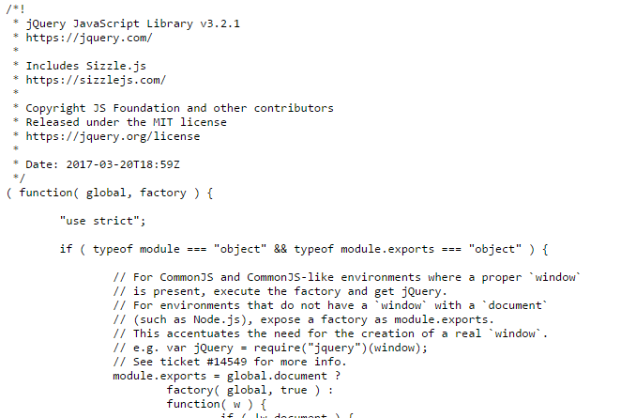
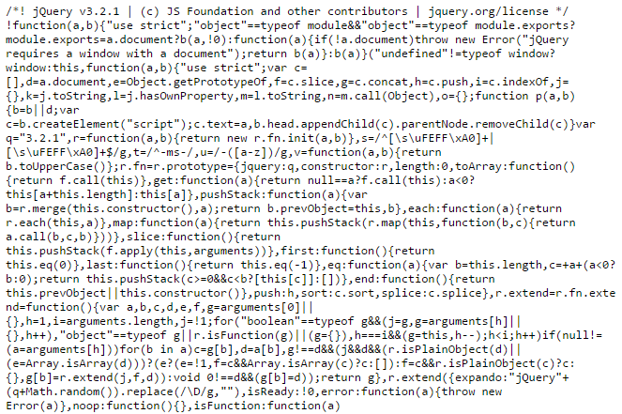
Web Optimization – a standard practice
Verbose – human readable | Minified – machine optimized
https://cdnjs.cloudflare.com/ajax/libs/jquery/3.2.1/jquery.js -- 262 KB | https://cdnjs.cloudflare.com/ajax/libs/jquery/3.2.1/jquery.min.js -- 85 KB

Slide 8

Schema Design and Use
Profiles
{
"meta": {
"module": "openc2"
},
"types": [
["OpenC2Command", "Record", [],
[1, "action", "Action", [],
[2, "target", "Target", [],
[3, "actuator", "Actuator", [
[4, "modifiers", "Modifiers",
]]
]
}
Use Cases
Language Description
OpenC2 (TC working docs)
OpenC2Command ::= RECORD {
action Action,
target Target,
actuator Actuator OPTIONAL,
modifiers Modifiers OPTIONAL
}
Design abstract schema based on requirements and standard docs
Translate
Tag | Prop | Type
1 | action | String
2 | target | TargetType
3 | actuator | ActuatorType
4 | modifiers | ModifiersType
JAEN Source (JAS)
(optional)
JAEN (normative)
Dynamic Load
Property Tables (imported data models)
Orchestrator
Encoder
Decoder
Actuator
OpenC2
(deny)
JSON or Binary
API (Application Programming Interface)
Encoding (Message Formats)

Slide 9
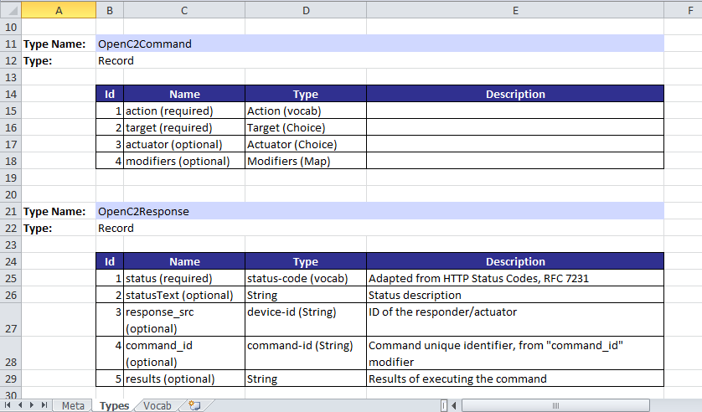
Auto-generated Property Tables
["OpenC2Command", "Record", [], "", [
[1, "action", "Action", [], ""],
[2, "target", "Target", [], ""],
[3, "actuator", "Actuator", ["?"], ""],
[4, "modifiers", "Modifiers", ["?"], ""]]],
["OpenC2Response", "Record", [], "", [
[1, "status", "status-code", [], "Adapted from HTTP Status Codes, RFC 7231"],
[2, "statusText", "String", ["?"], "Status description"],
[3, "response_src", "device-id", ["?"], "ID of the responder/actuator"],
[4, "command_id", "command-id", ["?"], "Command unique identifier, from \"command_id\" modifier"],
[5, "results", "String", ["?"], "Results of executing the command"]]],
JAEN
Property Tables

Slide 10
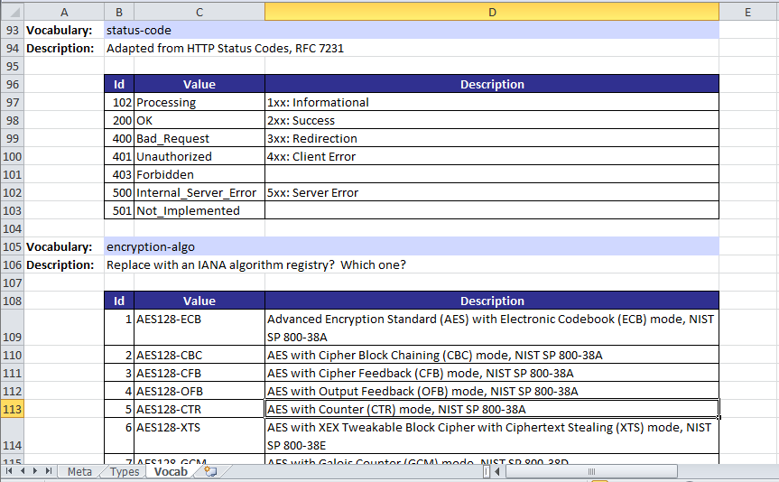
Auto-generated Property Tables (cont.)
["status-code", "Enumerated", [], "Adapted from HTTP Status Codes, RFC 7231", [
[102, "Processing", "1xx: Informational"],
[200, "OK", "2xx: Success"],
[400, "Bad_Request", "3xx: Redirection"],
[401, "Unauthorized", "4xx: Client Error"],
[403, "Forbidden", ""],
[500, "Internal_Server_Error", "5xx: Server Error"],
[501, "Not_Implemented", ""]]],
["encryption-algo", "Enumerated", [], "Replace with an IANA algorithm registry? Which one?", [
[1, "AES128-ECB", "Advanced Encryption Standard (AES) with Electronic Codebook (ECB) mode, NIST SP 800-38A"],
JAEN
Property Tables
Notes:
Example shows subsetting of a standard IETF vocabulary registry.

Slide 11
Auto-generated Property Tables (cont.)
JAEN is not a mysterious foreign language
Machine-readable (JSON)
Constrained content
Represents a valid schema (verifiable)
Structured text (but description field is free-form)
Directly representable in property table format
By design
Notes:
Original JAEN design requirement was to be a formal machine representation of schemas expressed informally in property table format.

Slide 12
MRPT

Slide 13
Schema Design and Use (hand-coding)
Profiles
{
"meta": {
"module": "openc2"
},
"types": [
["OpenC2Command", "Record", [],
[1, "action", "Action", [],
[2, "target", "Target", [],
[3, "actuator", "Actuator", [
[4, "modifiers", "Modifiers",
]]
]
}
Use Cases
Tag | Prop | Type
1 | action | String
2 | target | TargetType
3 | actuator | ActuatorType
4 | modifiers | ModifiersType
Language Description
OpenC2 (TC working docs)
Auto-Generate
Design abstract schema based on requirements and standard docs
Property Tables
JAEN (normative)
Write code
Orchestrator
Actuator
OpenC2
(deny)
JSON-V

Slide 14
OpenC2 Message Definition
STIX: Standard contains property tables and JSON examples
Property tables are normative but not testable
Member-developed JSON Schemas are testable but are not part of the STIX standard
No path to efficient message encoding for production systems
OpenC2: Standard contains schema and examples
Abstract schema is normative and testable
Property tables are auto-generated from normative schema
Member-developed concrete schemas (JSON and Binary) are derived from abstract schema and are testable
Goal: auto-generation of concrete schemas from abstract schema
Examples have been validated against normative schema

Slide 15

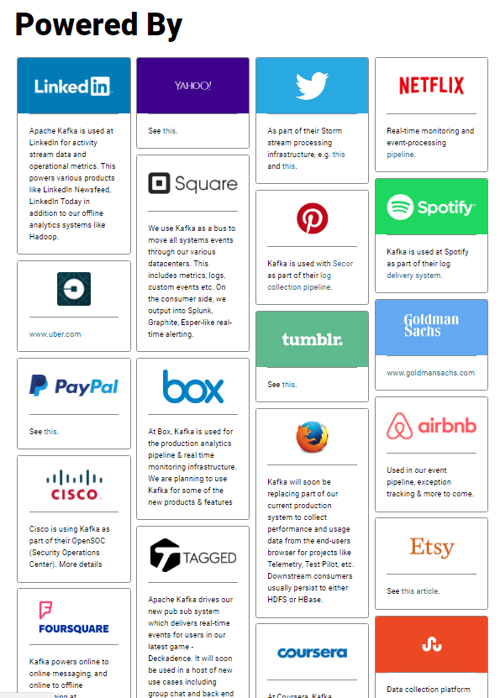

Who uses schemas?
Data Serialization:
Apache Avro
JAEN
Messaging:
Apache Kafka
OpenDXL
“Though Kafka itself is serialization-agnostic, LinkedIn has standardized on the use of Apache Avro as the schema and serialization language for all of its activity data messages as well as data in Hadoop and most other data systems. In uncompressed form our Avro data was roughly 7 times smaller than XML messages in the activity logging system we replaced.”
“This pipeline currently runs in production at LinkedIn and handles more than 10 billion message writes each day with a sustained peak of over 172,000 messages per second.”
“Building LinkedIn’s Real-time Activity Data Pipeline” http://sites.computer.org/debull/A12june/pipeline.pdf
https://kafka.apache.org/powered-by

Slide 16
OpenC2 Design Choices
“Avro specifies two serialization encodings: binary and JSON. Most applications will use the binary encoding, as it is smaller and faster. But, for debugging and web-based applications, the JSON encoding may sometimes be appropriate.”
--- https://avro.apache.org/docs/current/spec.html
Avro is widely deployed, why create JAEN?
Direct correspondence with STIX property tables
Avro schemas are mandatory; JAEN interoperates with schema-less implementations
Multiple JSON encodings
JSON-minified is an efficient text-based alternative to binary
More flexible reverse-engineered abstract schemas?
Difficulty of specifying some existing JSON datatypes (e.g., ATVs) in Avro is unknown
Way forward:
Short term – add Avro capabilities to JAEN, harmonize nomenclature
Namespaces, binary encoding, fixed datatypes, …
Mid term – Switch OpenC2 normative schema to Avro or CDDL if feasible
Would require property table generation
Notes:
Is Avro transport-agnostic? Usable in Client-Server / REST applications that don’t do schema negotiation?
Goal: use a mainstream schema engine like Avro if it can support interoperability with non-Avro implementations, which is an absolute requirement.

Slide 17
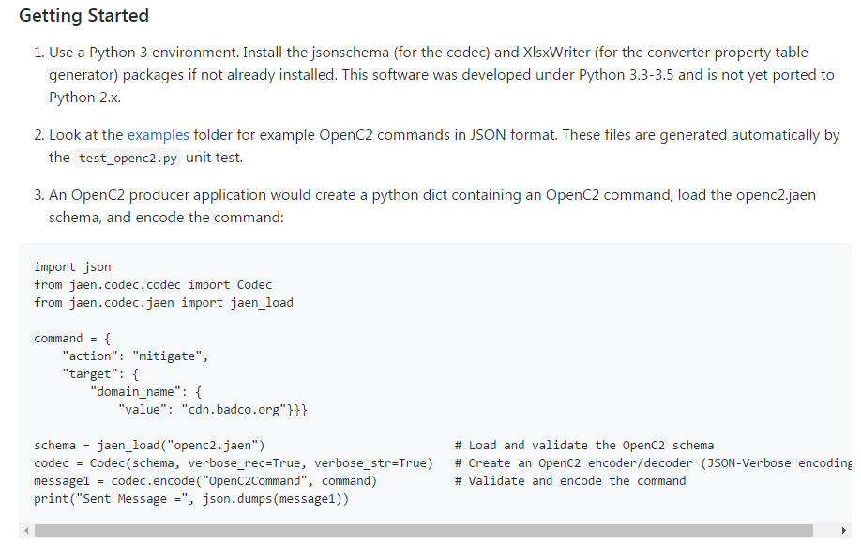
Getting Started
Install JAEN software
https://github.com/OpenC2-org/jaen
Run example_app
View and run unit test files
Comprehensive examples for using and testing the JAEN codec
If schema is modified:
Run jaen_convert to generate derived schemas
Re-run unit tests to generate example messages

Slide 18
FAQ
Q: If targets have no “type” property, how does one find their type?
A: Mapping types (Python dicts, JSON objects) are collections of key: value pairs. When an object has only one item, the key is the type of that item.
Attribute: target = {"type":"ipv4", "value":"1.2.3.4"} type = target["type"]
Property: target = {"ipv4": "1.2.3.4"} for key in target: type = key -- or -- type = next(iter(target))
Notes:
Because Python dictionaries are not ordered, it is not possible to specify the “key of the first item”, e.g., type = target[0].keys().
next(iter(x)) is a Python idiom for returning the keys of a dictionary x in arbitrary order. But since there is only one key, order doesn’t matter.

Slide 19
BACKUP

